Slide 1
Digital Design & Computer Arch.
Lecture 13: Pipelining
Prof. Onur Mutlu
ETH Zürich
Spring 2020
2 April 2020

Slide 2
Required Readings
This week
  Pipelining
    H&H, Chapter 7.5
  Pipelining Issues
    H&H, Chapter 7.8.1-7.8.3
Next week
  Out-of-order execution
    H&H, Chapter 7.8-7.9
  Smith and Sohi, “The Microarchitecture of Superscalar Processors,” Proceedings of the IEEE, 1995
    More advanced pipelining
    Interrupt and exception handling
    Out-of-order and superscalar execution concepts

Slide 3
Agenda for Today & Next Few Lectures
Last week
  Single-cycle Microarchitectures
  Multi-cycle Microarchitectures
This week
  Pipelining
  Issues in Pipelining: Control & Data Dependence Handling, State Maintenance and Recovery, …
Next week
  Out-of-Order Execution
  Issues in OoO Execution: Load-Store Handling, …

Slide 4
Can We Do Better?

Slide 5
Can We Do Better?
What limitations do you see with the multi-cycle design?
Limited concurrency
  Some hardware resources are idle during different phases of instruction processing cycle
  “Fetch” logic is idle when an instruction is being “decoded” or “executed”
  Most of the datapath is idle when a memory access is happening

Slide 6
Can We Use the Idle Hardware to Improve Concurrency?
Goal: More concurrency → Higher instruction throughput (i.e., more “work” completed in one cycle)
Idea: When an instruction is using some resources in its processing phase, process other instructions on idle resources not needed by that instruction
  E.g., when an instruction is being decoded, fetch the next instruction
  E.g., when an instruction is being executed, decode another instruction
  E.g., when an instruction is accessing data memory (ld/st), execute the next instruction
  E.g., when an instruction is writing its result into the register file, access data memory for the next instruction

Slide 7
Pipelining

Slide 8
Pipelining: Basic Idea
More systematically:
  Pipeline the execution of multiple instructions
  Analogy: “Assembly line processing” of instructions
Idea:
  Divide the instruction processing cycle into distinct “stages” of processing
  Ensure there are enough hardware resources to process one instruction in each stage
  Process a different instruction in each stage
    Instructions consecutive in program order are processed in consecutive stages
Benefit: Increases instruction processing throughput (1/CPI)
Downside: Start thinking about this…

Slide 9
Example: Execution of Four Independent ADDs
Multi-cycle: 4 cycles per instruction
Pipelined: 4 cycles per 4 instructions (steady state)
F
D
E
W
F
D
E
W
F
D
E
W
F
D
E
W
Time
F
D
E
W
F
D
E
W
Is life always this beautiful?
F
D
E
W
F
D
E
W
Time

Slide 10
The Laundry Analogy
“place one dirty load of clothes in the washer”
“when the washer is finished, place the wet load in the dryer”
“when the dryer is finished, take out the dry load and fold”
“when folding is finished, ask your roommate (??) to put the clothes away”
- steps to do a load are sequentially dependent
- no dependence between different loads
- different steps do not share resources
Based on original figure from [P&H CO&D, COPYRIGHT 2004 Elsevier. ALL RIGHTS RESERVED.]

Slide 11
Pipelining Multiple Loads of Laundry
- 4 loads of laundry in parallel
- no additional resources
- throughput increased by 4
- latency per load is the same
Based on original figure from [P&H CO&D, COPYRIGHT 2004 Elsevier. ALL RIGHTS RESERVED.]

Slide 12




Pipelining Multiple Loads of Laundry: In Practice
the slowest step decides throughput
Based on original figure from [P&H CO&D, COPYRIGHT 2004 Elsevier. ALL RIGHTS RESERVED.]

Slide 13
Pipelining Multiple Loads of Laundry: In Practice
A
B
A
B
throughput restored (2 loads per hour) using 2 dryers
Based on original figure from [P&H CO&D, COPYRIGHT 2004 Elsevier. ALL RIGHTS RESERVED.]

Slide 14
An Ideal Pipeline
Goal: Increase throughput with little increase in cost (hardware cost, in case of instruction processing)
Repetition of identical operations
  The same operation is repeated on a large number of different inputs (e.g., all laundry loads go through the same steps)
Repetition of independent operations
  No dependencies between repeated operations
Uniformly partitionable suboperations
  Processing can be evenly divided into uniform-latency suboperations (that do not share resources)
Fitting examples: automobile assembly line, doing laundry
  What about the instruction processing “cycle”?

Slide 15
Ideal Pipelining
combinational logic (F,D,E,M,W)
T psec
BW=~(1/T)
T/2 ps (F,D,E)
T/2 ps (M,W)
BW=~(2/T)
T/3
ps (F,D)
T/3
ps (E,M)
T/3
ps (M,W)
BW=~(3/T)

Slide 16
More Realistic Pipeline: Throughput
Nonpipelined version with delay T
BW = 1/(T+S) where S = latch delay
k-stage pipelined version
BW_{k-stage} = 1 / (T/k +S )
BW_{max} = 1 / (1 gate delay + S )
T ps
Latch delay reduces throughput
(switching overhead b/w stages)
T/k
ps
T/k
ps

Slide 17
More Realistic Pipeline: Cost
Nonpipelined version with combinational cost G
Cost = G+L where L = latch cost
k-stage pipelined version
Cost_{k-stage} = G + Lk
G gates
Latches increase hardware cost
G/k
G/k

Slide 18
Pipelining Instruction Processing

Slide 19
Remember: The Instruction Processing Cycle
  Fetch
  Decode
  Evaluate Address
  Fetch Operands
  Execute
  Store Result
  1. Instruction fetch (IF)
  2. Instruction decode and
  register operand fetch (ID/RF)
  3. Execute/Evaluate memory address (EX/AG)
  4. Memory operand fetch (MEM)
  5. Store/writeback result (WB)

Slide 20
Remember the Single-Cycle Uarch
PCSrc₁=Jump
PCSrc₂=Br Taken
bcond
ALU operation
T
BW=~(1/T)
Based on original figure from [P&H CO&D, COPYRIGHT 2004 Elsevier. ALL RIGHTS RESERVED.]

Slide 21
Dividing Into Stages
200ps
100ps
200ps
200ps
100ps
ignore
for now
RF
write
Is this the correct partitioning?
Why not 4 or 6 stages? Why not different boundaries?
Based on original figure from [P&H CO&D, COPYRIGHT 2004 Elsevier. ALL RIGHTS RESERVED.]

Slide 22
Instruction Pipeline Throughput
200 400 600 800 1000 1200 1400 1600 1800
800ps
800ps
800ps
200 400 600 800 1000 1200 1400
200ps
200ps
200ps
200ps
200ps
200ps
200ps
5-stage speedup is 4, not 5 as predicted by the ideal model. Why?

Slide 23
Enabling Pipelined Processing: Pipeline Registers
No resource is used by more than 1 stage!
PC_{D}+4
PC_{E}+4
nPC_{M}
PC_{F}
A_{E}
IR_{D}
Aout_{M}
B_{E}
MDR_{W}
B_{M}
Imm_{E}
Aout_{W}
T/k
ps
T
T/k
ps
Based on original figure from [P&H CO&D, COPYRIGHT 2004 Elsevier. ALL RIGHTS RESERVED.]

Slide 24
Pipelined Operation Example
All instruction classes must follow the same path
and timing through the pipeline stages.
Any performance impact?
Based on original figure from [P&H CO&D, COPYRIGHT 2004 Elsevier. ALL RIGHTS RESERVED.]

Slide 25
Pipelined Operation Example
Is life always this beautiful?
Based on original figure from [P&H CO&D, COPYRIGHT 2004 Elsevier. ALL RIGHTS RESERVED.]

Slide 26
Illustrating Pipeline Operation: Operation View
t₀
t₁
t₂
t₃
t₄
t₅
Inst₀
IF
ID
EX
MEM
WB
Inst₁
IF
ID
EX
MEM
WB
Inst₂
IF
ID
EX
MEM
WB
Inst₃
IF
ID
EX
MEM
WB
Inst₄
IF
ID
EX
MEM
IF
ID
EX
IF
ID
steady state
(full pipeline)
IF

Slide 27
Illustrating Pipeline Operation: Resource View
 | t₀ | t₁ | t₂ | t₃ | t₄ | t₅ | t₆ | t₇ | t₈ | t₉ | t₁₀
IF
ID
EX
MEM
WB
I₀
I₁
I₂
I₃
I₄
I₅
I₆
I₇
I₈
I₉
I₁₀
I₀
I₁
I₂
I₃
I₄
I₅
I₆
I₇
I₈
I₉
I₀
I₁
I₂
I₃
I₄
I₅
I₆
I₇
I₈
I₀
I₁
I₂
I₃
I₄
I₅
I₆
I₇
I₀
I₁
I₂
I₃
I₄
I₅
I₆

Slide 28
Control Points in a Pipeline
Based on original figure from [P&H CO&D, COPYRIGHT 2004 Elsevier. ALL RIGHTS RESERVED.]
Identical set of control points as the single-cycle datapath!!

Slide 29
Control Signals in a Pipeline
For a given instruction
  same control signals as single-cycle, but
  control signals required at different cycles, depending on stage
  Option 1: decode once using the same logic as single-cycle and buffer signals until consumed
  Option 2: carry relevant “instruction word/field” down the pipeline and decode locally within each or in a previous stage
  Which one is better?

Slide 30
Pipelined Control Signals
Based on original figure from [P&H CO&D, COPYRIGHT 2004 Elsevier. ALL RIGHTS RESERVED.]

Slide 31
Another Example: Single-Cycle and Pipelined

Slide 32
Another Example: Correct Pipelined Datapath
WriteReg must arrive at the same time as Result

Slide 33
Another Example: Pipelined Control
Same control unit as single-cycle processor
Control delayed to proper pipeline stage

Slide 34
Remember: An Ideal Pipeline
Goal: Increase throughput with little increase in cost (hardware cost, in case of instruction processing)
Repetition of identical operations
  The same operation is repeated on a large number of different inputs (e.g., all laundry loads go through the same steps)
Repetition of independent operations
  No dependencies between repeated operations
Uniformly partitionable suboperations
  Processing an be evenly divided into uniform-latency suboperations (that do not share resources)
Fitting examples: automobile assembly line, doing laundry
  What about the instruction processing “cycle”?

Slide 35
Instruction Pipeline: Not An Ideal Pipeline
Identical operations ... NOT!
⇒ different instructions → not all need the same stages
    Forcing different instructions to go through the same pipe stages
    → external fragmentation (some pipe stages idle for some instructions)
Uniform suboperations ... NOT!
⇒ different pipeline stages → not the same latency
Need to force each stage to be controlled by the same clock
    → internal fragmentation (some pipe stages are too fast but all take the same clock cycle time)
Independent operations ... NOT!
⇒ instructions are not independent of each other
    Need to detect and resolve inter-instruction dependencies to ensure the pipeline provides correct results
    → pipeline stalls (pipeline is not always moving)

Slide 36
Issues in Pipeline Design
Balancing work in pipeline stages
  How many stages and what is done in each stage
Keeping the pipeline correct, moving, and full in the presence of events that disrupt pipeline flow
  Handling dependences
    Data
    Control
  Handling resource contention
  Handling long-latency (multi-cycle) operations
Handling exceptions, interrupts
Advanced: Improving pipeline throughput
  Minimizing stalls

Slide 37
Causes of Pipeline Stalls
Stall: A condition when the pipeline stops moving
Resource contention
Dependences (between instructions)
  Data
  Control
Long-latency (multi-cycle) operations

Slide 38
Dependences and Their Types
Also called “dependency” or less desirably “hazard”
Dependences dictate ordering requirements between instructions
Two types
  Data dependence
  Control dependence
Resource contention is sometimes called resource dependence
  However, this is not fundamental to (dictated by) program semantics, so we will treat it separately

Slide 39
Handling Resource Contention
Happens when instructions in two pipeline stages need the same resource
Solution 1: Eliminate the cause of contention
  Duplicate the resource or increase its throughput
    E.g., use separate instruction and data memories (caches)
    E.g., use multiple ports for memory structures
Solution 2: Detect the resource contention and stall one of the contending stages
  Which stage do you stall?
  Example: What if you had a single read and write port for the register file?

Slide 40
Example Resource Dependence: RegFile
The register file can be read and written in the same cycle:
  write takes place during the 1st half of the cycle
  read takes place during the 2nd half of the cycle => no problem!!!
  However operations that involve register file have only half a clock cycle to complete the operation!!

Slide 41
Data Dependences
Types of data dependences
  Flow dependence (true data dependence – read after write)
  Output dependence (write after write)
  Anti dependence (write after read)
Which ones cause stalls in a pipelined machine?
  For all of them, we need to ensure semantics of the program is correct
  Flow dependences always need to be obeyed because they constitute true dependence on a value
  Anti and output dependences exist due to limited number of architectural registers
    They are dependence on a name, not a value
    We will later see what we can do about them

Slide 42
Data Dependence Types
Flow dependence
      r₃ ← r₁ op r₂ Read-after-Write
      r₅ ← r₃ op r₄ (RAW)
Anti dependence
      r₃ ← r₁ op r₂ Write-after-Read
      r₁ ← r₄ op r₅ (WAR)
Output-dependence
      r₃ ← r₁ op r₂ Write-after-Write
      r₅ ← r₃ op r₄ (WAW)
      r₃ ← r₆ op r₇

Slide 43
Pipelined Operation Example
What if the SUB were dependent on LW?
Based on original figure from [P&H CO&D, COPYRIGHT 2004 Elsevier. ALL RIGHTS RESERVED.]

Slide 44
Data Dependence Handling

Slide 45
Reading for Next Few Lectures
H&H, Chapter 7.5-7.9
Smith and Sohi, “The Microarchitecture of Superscalar Processors,” Proceedings of the IEEE, 1995
  More advanced pipelining
  Interrupt and exception handling
  Out-of-order and superscalar execution concepts

Slide 46
How to Handle Data Dependences
Anti and output dependences are easier to handle
  write to the destination in one stage and in program order
Flow dependences are more interesting
Five fundamental ways of handling flow dependences
  Detect and wait until value is available in register file
  Detect and forward/bypass data to dependent instruction
  Detect and eliminate the dependence at the software level
    No need for the hardware to detect dependence
  Predict the needed value(s), execute “speculatively”, and verify
  Do something else (fine-grained multithreading)
    No need to detect

Slide 47
Interlocking
Detection of dependence between instructions in a pipelined processor to guarantee correct execution
Software based interlocking
vs.
Hardware based interlocking
MIPS acronym?

Slide 48
Approaches to Dependence Detection (I)
Scoreboarding
  Each register in register file has a Valid bit associated with it
  An instruction that is writing to the register resets the Valid bit
  An instruction in Decode stage checks if all its source and destination registers are Valid
    Yes: No need to stall… No dependence
    No: Stall the instruction
Advantage:
  Simple. 1 bit per register
Disadvantage:
  Need to stall for all types of dependences, not only flow dep.

Slide 49
Not Stalling on Anti and Output Dependences
What changes would you make to the scoreboard to enable this?

Slide 50
Approaches to Dependence Detection (II)
Combinational dependence check logic
  Special logic that checks if any instruction in later stages is supposed to write to any source register of the instruction that is being decoded
  Yes: stall the instruction/pipeline
  No: no need to stall… no flow dependence
Advantage:
  No need to stall on anti and output dependences
Disadvantage:
  Logic is more complex than a scoreboard
  Logic becomes more complex as we make the pipeline deeper and wider (flash-forward: think superscalar execution)

Slide 51
Once You Detect the Dependence in Hardware
What do you do afterwards?
Observation: Dependence between two instructions is detected before the communicated data value becomes available
Option 1: Stall the dependent instruction right away
Option 2: Stall the dependent instruction only when necessary → data forwarding/bypassing
Option 3: …

Slide 52
Data Forwarding/Bypassing
Problem: A consumer (dependent) instruction has to wait in decode stage until the producer instruction writes its value in the register file
Goal: We do not want to stall the pipeline unnecessarily
Observation: The data value needed by the consumer instruction can be supplied directly from a later stage in the pipeline (instead of only from the register file)
Idea: Add additional dependence check logic and data forwarding paths (buses) to supply the producer’s value to the consumer right after the value is available
Benefit: Consumer can move in the pipeline until the point the value can be supplied → less stalling

Slide 53
A Special Case of Data Dependence
Control dependence
  Data dependence on the Instruction Pointer / Program Counter

Slide 54
Control Dependence
Question: What should the fetch PC be in the next cycle?
Answer: The address of the next instruction
  All instructions are control dependent on previous ones. Why?
If the fetched instruction is a non-control-flow instruction:
  Next Fetch PC is the address of the next-sequential instruction
  Easy to determine if we know the size of the fetched instruction
If the instruction that is fetched is a control-flow instruction:
  How do we determine the next Fetch PC?
In fact, how do we know whether or not the fetched instruction is a control-flow instruction?

Slide 55
Data Dependence Handling: Concepts and Implementation

Slide 56
Remember: Data Dependence Types
Flow dependence
      r₃ ← r₁ op r₂ Read-after-Write
      r₅ ← r₃ op r₄ (RAW)
Anti dependence
      r₃ ← r₁ op r₂ Write-after-Read
      r₁ ← r₄ op r₅ (WAR)
Output-dependence
      r₃ ← r₁ op r₂ Write-after-Write
      r₅ ← r₃ op r₄ (WAW)
      r₃ ← r₆ op r₇

Slide 57
RAW Dependence Handling
Which one of the following flow dependences lead to conflicts in the 5-stage pipeline?
addi ra r- -
IF
ID
EX
MEM
WB
addi r- ra -
IF
ID
EX
MEM
WB
addi r- ra -
IF
ID
EX
MEM
addi r- ra -
IF
ID
EX
IF
?
addi r- ra -
ID
addi r- ra -
IF

Slide 58
Pipeline Stall: Resolving Data Dependence
t₀
t₀
t₀
t₀
t₁
t₁
t₁
t₁
t₂
t₂
t₂
t₂
t₃
t₃
t₃
t₃
t₄
t₄
t₄
t₄
t₅
t₅
t₅
t₅
Inst_{h}
Inst_{h}
Inst_{h}
Inst_{h}
IF
IF
IF
IF
ID
ID
ID
ID
ALU
ALU
ALU
ALU
MEM
MEM
MEM
MEM
WB
WB
WB
WB
i
i
i
Inst_{i}
i
Inst_{i}
Inst_{i}
Inst_{i}
IF
IF
IF
IF
ID
ID
ID
ID
ALU
ALU
ALU
ALU
MEM
MEM
MEM
MEM
WB
WB
WB
WB
j
j
j
Inst_{j}
j
Inst_{j}
Inst_{j}
Inst_{j}
IF
IF
IF
IF
ID
ID
ID
ID
ALU
ID
ID
ID
MEM
ALU
ID
ID
WB
MEM
ALU
ID
WB
MEM
ALU
Inst_{k}
Inst_{k}
Inst_{k}
Inst_{k}
IF
IF
IF
IF
ID
IF
IF
IF
ALU
ID
IF
IF
MEM
ALU
ID
IF
WB
MEM
ALU
ID
Inst_{l}
Inst_{l}
Inst_{l}
Inst_{l}
IF
ID
IF
ALU
ID
IF
MEM
ALU
ID
IF
IF
ID
IF
ALU
ID
IF
i: r_{x} ← _
j: _ ← r_{x} dist(i,j)=1
i: r_{x} ← _
bubble
j: _ ← r_{x} dist(i,j)=2
i: r_{x} ← _
bubble
bubble
j: _ ← r_{x} dist(i,j)=3
i: r_{x} ← _
bubble
bubble
bubble
j: _ ← r_{x} dist(i,j)=4
IF
ID
IF
Stall = make the dependent instruction
wait until its source data value is available
1. stop all up-stream stages
2. drain all down-stream stages
IF

Slide 59
How to Implement Stalling
Stall
  disable PC and IF/ID latching; ensure stalled instruction stays in its stage
  Insert “invalid” instructions/nops into the stage following the stalled one (called “bubbles”)
Based on original figure from [P&H CO&D, COPYRIGHT 2004 Elsevier. ALL RIGHTS RESERVED.]

Slide 60
RAW Data Dependence Example
One instruction writes a register ($s0) and next instructions read this register => read after write (RAW) dependence.
  add writes into $s0 in the first half of cycle 5
  and reads $s0 on cycle 3, obtaining the wrong value
  or reads $s0 on cycle 4, again obtaining the wrong value.
  sub reads $s0 in the second half of cycle 5, obtaining the correct value
  subsequent instructions read the correct value of $s0
Only if the pipeline handles data dependences wrong!

Slide 61
Compile-Time Detection and Elimination
Insert enough NOPs for the required result to be ready
Or (if you can) move independent useful instructions up

Slide 62
Data Forwarding
Also called Data Bypassing
We have already seen the basic idea before
Forward the result value to the dependent instruction as soon as the value is available
Remember dataflow?
  Data value supplied to dependent instruction as soon as it is available
  Instruction executes when all its operands are available
Data forwarding brings a pipeline closer to data flow execution principles

Slide 63
Data Forwarding

Slide 64
Data Forwarding

Slide 65
Data Forwarding
Forward to Execute stage from either:
  Memory stage or
  Writeback stage
When should we forward from one either Memory or Writeback stage?
  If that stage will write a destination register and the destination register matches the source register.
  If both the Memory and Writeback stages contain matching destination registers, the Memory stage should have priority, because it contains the more recently executed instruction.

Slide 66
Data Forwarding
Forward to Execute stage from either:
  Memory stage or
  Writeback stage
Forwarding logic for ForwardAE (pseudo code):
if ((rsE != 0) AND (rsE == WriteRegM) AND RegWriteM) then ForwardAE = 10 # forward from Memory stage
else if ((rsE != 0) AND (rsE == WriteRegW) AND RegWriteW) then ForwardAE = 01 # forward from Writeback stage
else
ForwardAE = 00 # no forwarding
Forwarding logic for ForwardBE same, but replace rsE with rtE

Slide 67
Stalling
Forwarding is sufficient to resolve RAW data dependences
but …
There are cases when forwarding is not possible due to pipeline design and instruction latencies

Slide 68
Stalling
The lw instruction does not finish reading data until the end of the Memory stage, so its result cannot be forwarded to the Execute stage of the next instruction.

Slide 69
Stalling
The lw instruction has a two-cycle latency, therefore a dependent instruction cannot use its result until two cycles later.
The lw instruction receives data from memory at the end of cycle 4. But the and instruction needs that data as a source operand at the beginning of cycle 4. There is no way to supply the data with forwarding.

Slide 70
Stalling

Slide 71
Stalling Hardware
Stalls are supported by:
  adding enable inputs (EN) to the Fetch and Decode pipeline registers
  and a synchronous reset/clear (CLR) input to the Execute pipeline register
    or an INV bit associated with each pipeline register
When a lw stall occurs
  StallD and StallF are asserted to force the Decode and Fetch stage pipeline registers to hold their old values.
  FlushE is also asserted to clear the contents of the Execute stage pipeline register, introducing a bubble

Slide 72
Digital Design & Computer Arch.
Lecture 13: Pipelining
Prof. Onur Mutlu
ETH Zürich
Spring 2020
2 April 2020

Slide 73
We did not cover the following slides. They are for your benefit.

Slide 74
How to Handle Data Dependences
Anti and output dependences are easier to handle
  write to the destination in one stage and in program order
Flow dependences are more interesting
Five fundamental ways of handling flow dependences
  Detect and wait until value is available in register file
  Detect and forward/bypass data to dependent instruction
  Detect and eliminate the dependence at the software level
    No need for the hardware to detect dependence
  Predict the needed value(s), execute “speculatively”, and verify
  Do something else (fine-grained multithreading)
    No need to detect

Slide 75
Fine-Grained Multithreading

Slide 76
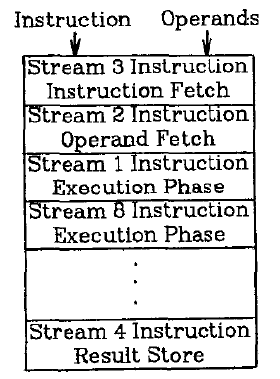
Fine-Grained Multithreading
Idea: Hardware has multiple thread contexts (PC+registers). Each cycle, fetch engine fetches from a different thread.
  By the time the fetched branch/instruction resolves, no instruction is fetched from the same thread
  Branch/instruction resolution latency overlapped with execution of other threads’ instructions
+ No logic needed for handling control and
data dependences within a thread
-- Single thread performance suffers
-- Extra logic for keeping thread contexts
-- Does not overlap latency if not enough
threads to cover the whole pipeline
Notes:
Latency overlap/hiding

Slide 77
Fine-Grained Multithreading (II)
Idea: Switch to another thread every cycle such that no two instructions from a thread are in the pipeline concurrently
Tolerates the control and data dependency latencies by overlapping the latency with useful work from other threads
Improves pipeline utilization by taking advantage of multiple threads
  Thornton, “Parallel Operation in the Control Data 6600,” AFIPS 1964.
  Smith, “A pipelined, shared resource MIMD computer,” ICPP 1978.

Slide 78
Fine-Grained Multithreading: History
CDC 6600’s peripheral processing unit is fine-grained multithreaded
  Thornton, “Parallel Operation in the Control Data 6600,” AFIPS 1964.
  Processor executes a different I/O thread every cycle
  An operation from the same thread is executed every 10 cycles
Denelcor HEP (Heterogeneous Element Processor)
  Smith, “A pipelined, shared resource MIMD computer,” ICPP 1978.
  120 threads/processor
  available queue vs. unavailable (waiting) queue for threads
  each thread can have only 1 instruction in the processor pipeline; each thread independent
  to each thread, processor looks like a non-pipelined machine
  system throughput vs. single thread performance tradeoff

Slide 79
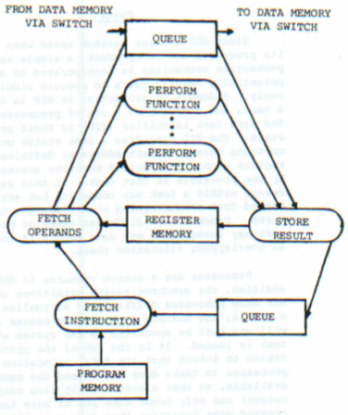

Fine-Grained Multithreading in HEP
Cycle time: 100ns
8 stages → 800 ns to complete an instruction
  assuming no memory access
No control and data dependency checking

Slide 80
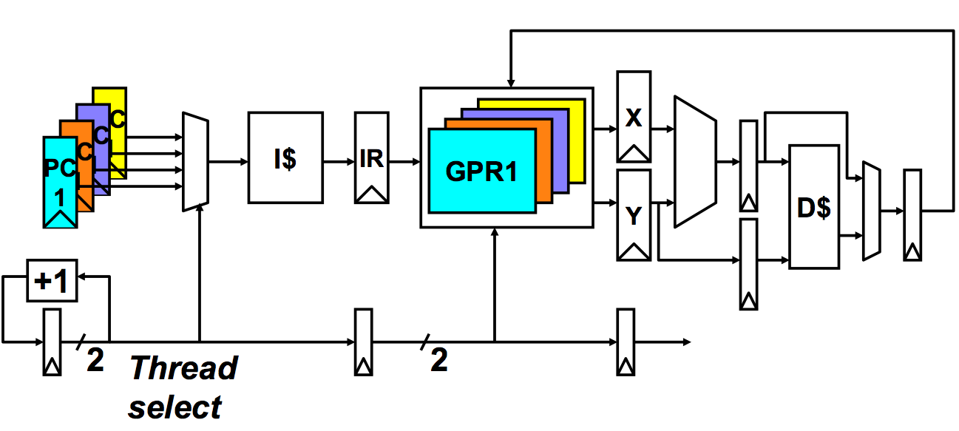
Multithreaded Pipeline Example
Slide credit: Joel Emer

Slide 81
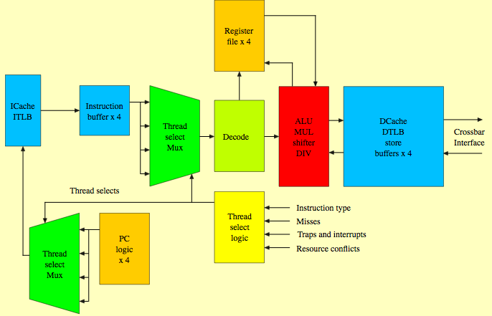
Sun Niagara Multithreaded Pipeline
Kongetira et al., “Niagara: A 32-Way Multithreaded Sparc Processor,” IEEE Micro 2005.

Slide 82
Fine-grained Multithreading
Advantages
  + No need for dependency checking between instructions
  (only one instruction in pipeline from a single thread)
  + No need for branch prediction logic
  + Otherwise-bubble cycles used for executing useful instructions from different threads
  + Improved system throughput, latency tolerance, utilization
Disadvantages
  - Extra hardware complexity: multiple hardware contexts (PCs, register files, …), thread selection logic
  - Reduced single thread performance (one instruction fetched every N cycles from the same thread)
  - Resource contention between threads in caches and memory
  - Some dependency checking logic between threads remains (load/store)

Slide 83
Modern GPUs Are FGMT Machines

Slide 84
NVIDIA GeForce GTX 285 “core”
64 KB of storage
for thread contexts (registers)
…
= data-parallel (SIMD) func. unit,
control shared across 8 units
= instruction stream decode
= multiply-add
= execution context storage
= multiply
Slide credit: Kayvon Fatahalian
Notes:
30 * 32 * 32 = 30 * 1024 = 30K fragments
64KB register file = 16 32-bit registers per thread = 64B (1/32 that of LRB)
16KB of shared scratch
80KB / core available to software

Slide 85
NVIDIA GeForce GTX 285 “core”
64 KB of storage
for thread contexts (registers)
…
Groups of 32 threads share instruction stream (each group is a Warp): they execute the same instruction on different data
Up to 32 warps are interleaved in an FGMT manner
Up to 1024 thread contexts can be stored
Slide credit: Kayvon Fatahalian
Notes:
To get maximal latency hiding:
Run 1/32 of the time
16 words per thread = 64B

Slide 86
NVIDIA GeForce GTX 285
Tex
Tex
…
…
…
…
…
…
Tex
Tex
…
…
…
…
…
…
Tex
Tex
…
…
…
…
…
…
Tex
Tex
…
…
…
…
…
…
Tex
Tex
…
…
…
…
…
…
30 cores on the GTX 285: 30,720 threads
Slide credit: Kayvon Fatahalian
Notes:
If you’re running a CUDA program, and your not launching 30K threads, you are certainly not getting full latency hiding, and you might not be using the GPU well

Slide 87
End of
Fine-Grained Multithreading

